Slide 1
WORKING STRESS METHOD

Slide 2
This method is based on elastic theory of reinforced concrete structure.
ASSUMPTIONS:-
Plane sections before bending remains plane even after bending
All tensile stress are taken by reinforcement
The modular ratio between steel and concrete remains constant.
M= Es/Ec
The stress strain relationship under working load is linear for both steel and concrete.

Slide 3
Advantages:-
It is simple, reliable and serviceability requirements are satisify.
Limitations:-
It assumes stress strain relationship for concrete is linear which is not true.
This method gives uneconomical section.

Slide 4
Ultimate Load Method
Ultimate load is used as a design load
Collapse criteria used for the design, hence it gives the better load carrying capacity for the structures.
This method gives economical section but it leads to excessive deformation and cracking.
This method failed in serviceability and durability criteria

Slide 5
Limit State Method
An ideal method which takes into account not only the ultimate strength of the structure but also the serviceability and durability requirement.
This new method makes a judicious combination of the working stress philosophy as well as the ultimate load philosophy, thus avoiding the demerits of both.

Slide 6
The acceptable limit of safety and serviceability requirements before failure occurs is called Limit State.
The structure to be designed on the basis of limit state should satisfy the following:-
a) Limit state of collapse
b) Limit state of serviceability
Limit state of collapse:-
Limit state of collapse in compression
Limit state of collapse in shear
Limit state of collapse in torsion

Slide 7
Limit State of serviceability
Excessive deflection
Premature or excessive cracking
Corrosion
Excessive Vibration

Slide 8
Comparision
Working Stress Method
Limit State Method
Based on elastic theory – assumes concrete and steel are elastic .
Assumes stress strain curve is linear for concrete and steel.
Factor of safety are applied to yield stresses to get permissible stresses.
No factor of safety is used for loads
Based on actual stress – strain curve of concrete and steel.
stress strain curve is non linear for concrete and steel.
Partial safety factors are applied to get design values of stresses
Design loads are obtained by multiplying partial safety factors to working loads

Slide 9
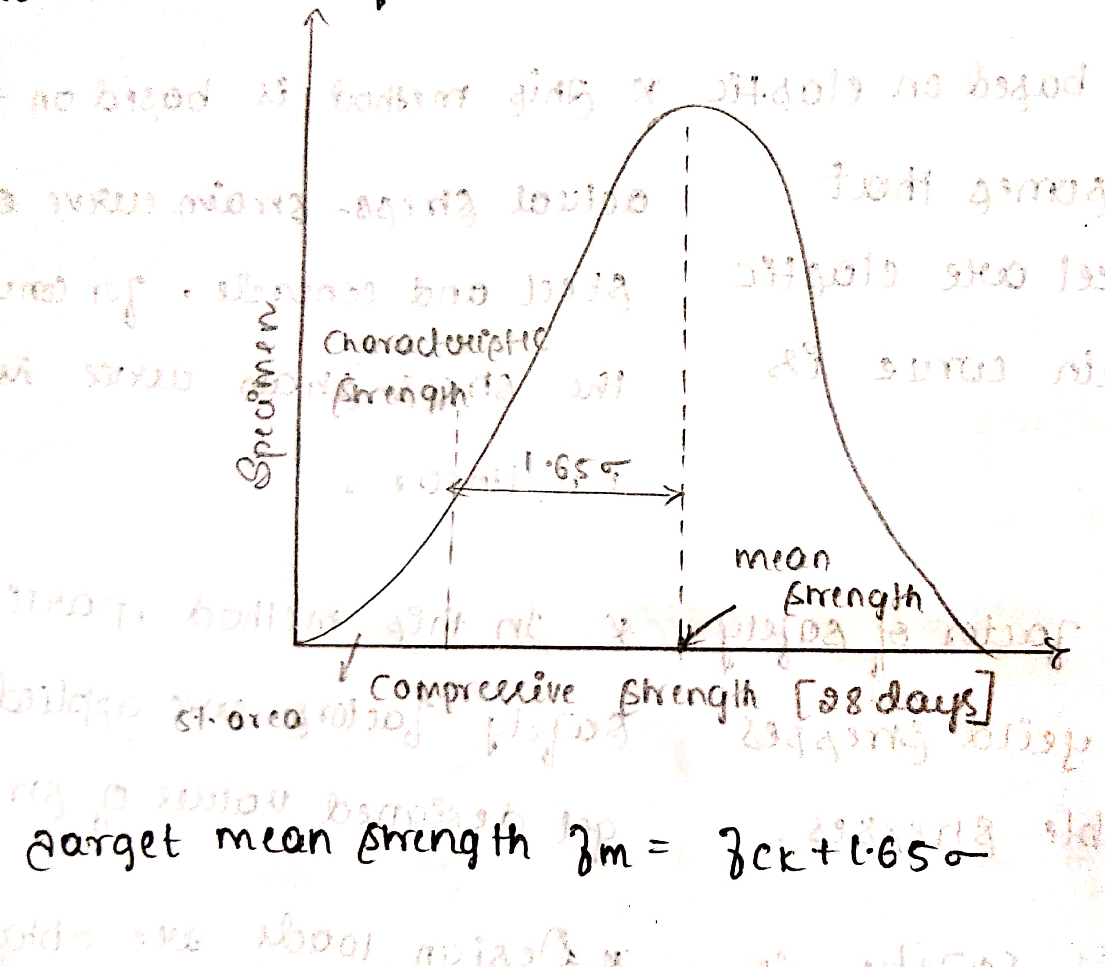
Characteristic Strength:-
The Characteristic strength of the material that value of the strength of the material below which not more than 5% of a test results are expected to fall.

Slide 10
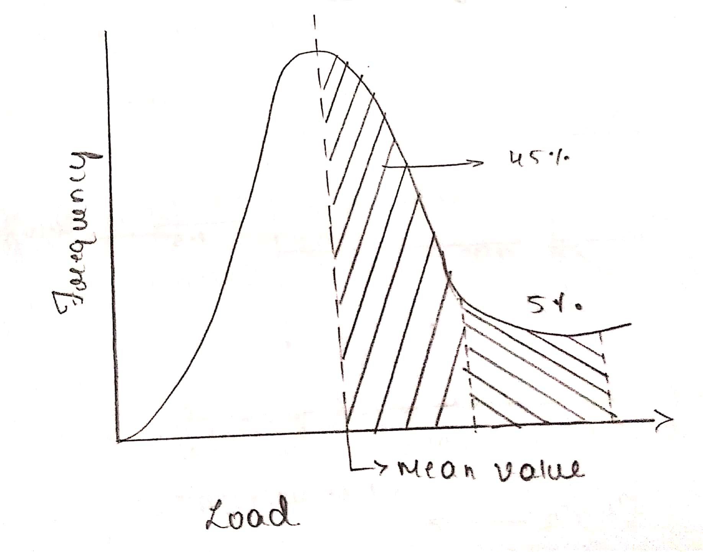
Characteristic Load:-
The maximum working load the structure has to withstand for which it has to be designed is called characteristic load
OR
It can also defined as the load that has 95% probability of not being exceeded during the life of structure.

Slide 11
Design Load:-
Defined as product of partial safety factor and characteristic load.
Partial Safety Factor
These are the factors which applied to the loads & materials to arrive at the designed values.
From IS -456:2000 (Table 18)
partial safety factor for steel=1.15
partial safety factor for steel=1.50

Slide 14
Proof Stress
Defined as the point when a material undergoes an amount of plastic deformation equal to 0.2%.
TYPES OF BEAM
I) Singly Reinforced Beam:
In a singly reinforced beam, the steel reinforced is provide only on tension zone or tensile side.
II) Doubly Reinforced Beam:
If steel reinforcement is provided in both tension and compression side, then it is said to be doubly reinforced beam.

Slide 15
Effective Depth (d): The distance from the top edge of the beam to the center of tensile reinforcement is called effective depth.
Clear Cover or Nominal Cover: The distance between bottom of the bar and bottom most edge of the beam is called clear cover or nominal cover.
Effective Cover(d’):The distance between center of tensile reinforcement and bottom edge of the beam is called effective cover.

Slide 16
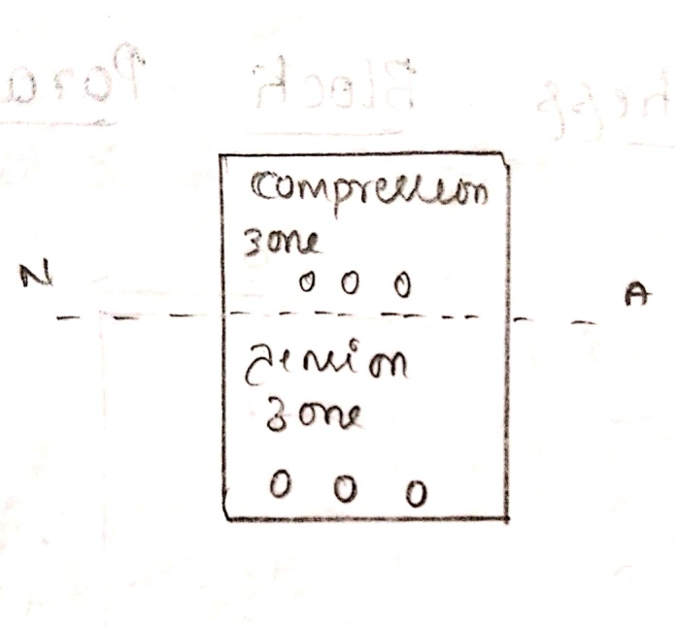

Slide 17
Stress Block Parameter

Slide 18
`

Slide 23
Balanced section
Strain in concrete and strain in steel reaches its limiting value simultaneously for the applied moment.
In this type of section neutral axis and limiting neutral axis coincides.

Slide 24
Under Reinforced Section
Strain in the steel reaches its limiting value first than the strain in concrete.
In this section percentage of steel is less than what is required for balanced section.

Slide 25
Over Reinforced Section
Strain in the concrete reaches its limiting value first than the strain in steel.
In this section percentage of steel is more than what is required for balanced section.

